Slide 1
HRM
CONCEPT OF HRM-
HRM is a process of brining people and organization together so that both can achieve their goal.
Art of procuring, developing and maintaining competent workforce to achieve the goals of an organization in an effective and efficient manner.

Slide 2
Major areas
Recruiting and staffing
Compensation and benefits
Training and learning
Labour and employee relations
OD

Slide 3
HRM FUNCTIONS
Managerial Function
Operative functions
Planning
Organizing
Directing
Controlling
Procurement
Development
Compensation
Integration
Maintenance

Slide 4
Some other primary functions
Staffing-right people at right job
Training and Development-enhance skill
Performance Standard- performance std
Compensation and benefits- salary, bonus incentives, retirement plan
Employee relations- handling grievance, conflict
Health and safety
Compliance-ensure compliance with labour laws, employment regulation
Employee engagement and retention- stay with org long term, WLB, org culture,

Slide 6
Significance of HRM
Significance for an enterprise
Professional significance
Social significance
National significance

Slide 7
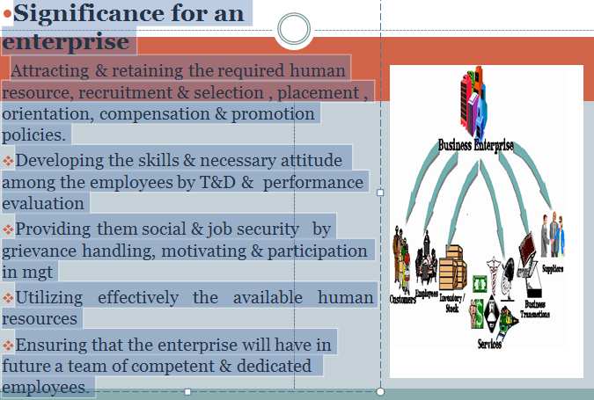

Slide 8
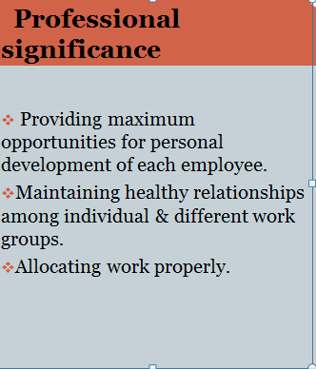

Slide 9
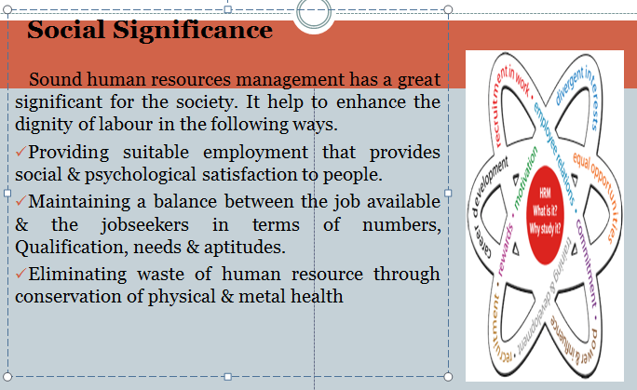

Slide 10
National significance
Increase in the size & complexity of organisation eg.MNC employees ,Rapid technological development like automation, computerisation
Rise of professional & knowledgeable workers, Increasing proportion of women in the workforce Growth of powerful nationwide trade unions.
Widening scope of legislation designed to protect the interests of the working class.
Revolution in the information technology that might affect the work force.
Rapidly changing jobs & skills requiring long-term manpower planning.
Growing Expectations of society from employers.

Slide 11
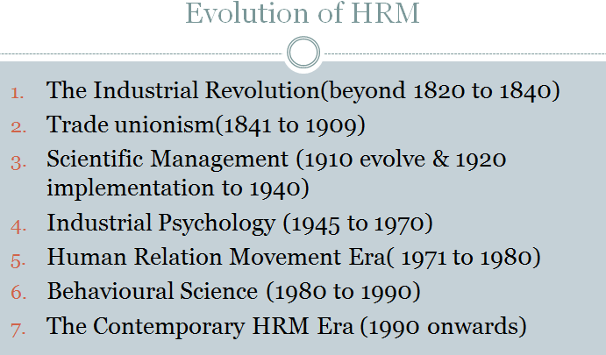

Slide 12
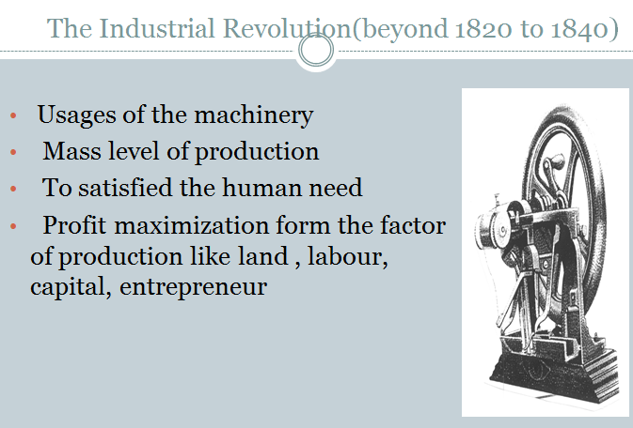

Slide 13
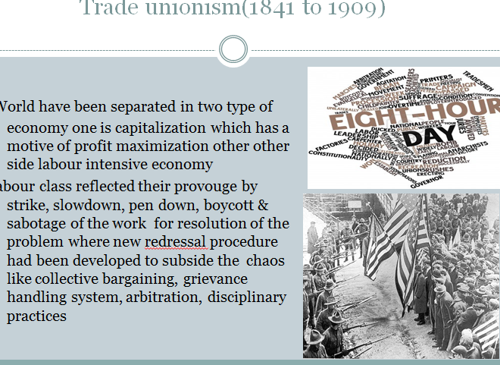

Slide 14
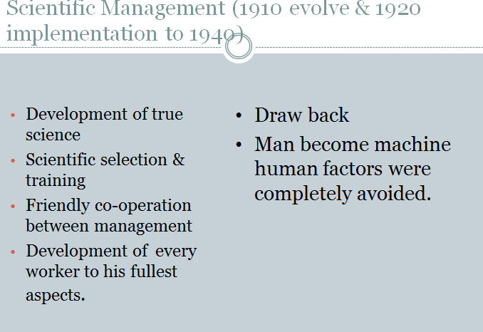

Slide 15
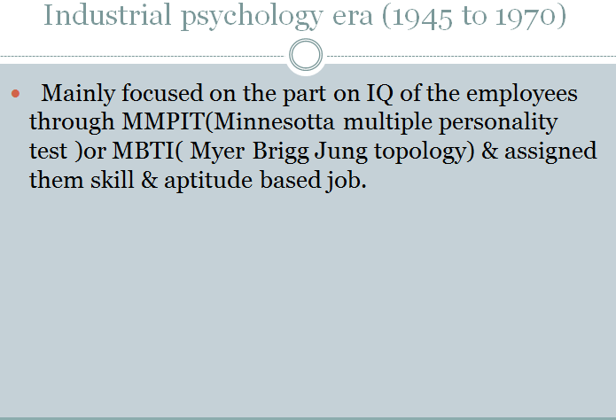

Slide 16
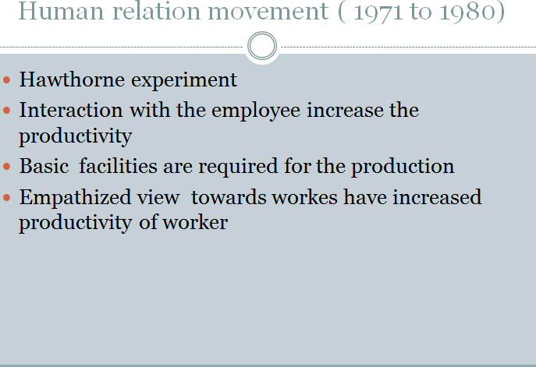

Slide 17
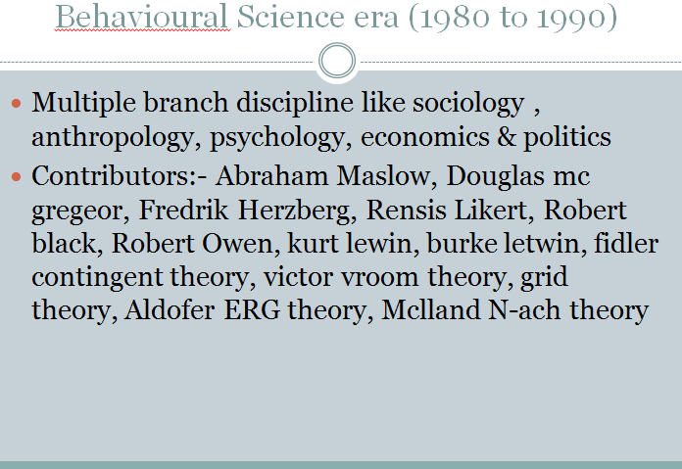

Slide 18
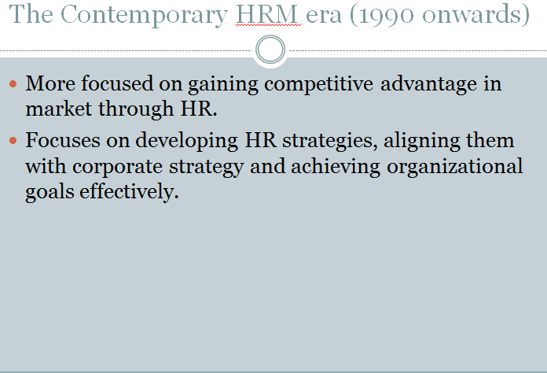

Slide 19
